Slide 1



Freshman Orientation
Welcome Class of 2023
1200 × 475

Slide 2

Counseling Office
Counselors:
Gorman Learning Center/Gorman Learning Center SBSC
Kody Miller
kmiller1@gormanlc.org
Gorman Learning Center/Gorman Learning Center SBSC
Dana Blood
dblood@gormanlc.org
Counselor Assistant:
Redlands Resource Center
Debbra Moser
dmoser@gormanlc.org
326 × 240

Slide 3


Slide 5








TWO SETS OF REQUIREMENTS HIGH SCHOOL:
High School Graduation Requirements
 Any level of the course
will count
 Must meet only the minimum requirements
 Earn credits with D- or better
4-Year University
Requirements, a.k.a.“A-G”
 Must take CP level or
higher
 Must often take courses above and beyond minimum requirements
 Must earn a C or better

Slide 6
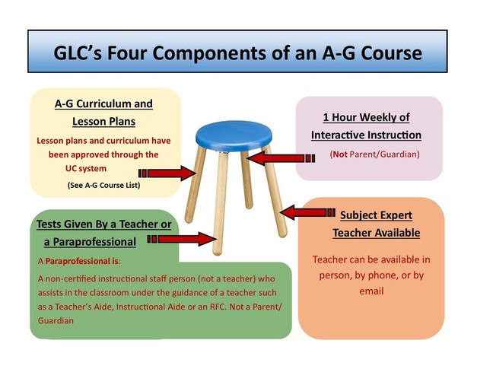
TWO SETS OF REQUIREMENTS HIGH SCHOOL:

Slide 7

SOCIAL SCIENCE REQUIREMENT
High School Graduation
A-G Requirement “Area A”:
Must pass the following with a “C” or
Better. All classes must be CP level or higher
1 YEAR
World History
1 YEAR
US History
1 SEMESTER
US Govt & Politics
1 SEMESTER
Economics
Each of the following
1 year World History
1 year US History
1 semester U.S. Government & Politics
1 semester Economics

Slide 8


ENGLISH REQUIREMENT
High School Graduation
 Four years of English
“A-G” Requirement “Area B”:
Four years of college prep level or higher. Must pass with grade of “C” or better.

Slide 9

MATH REQUIREMENT
High School Graduation
Two years of mathematics (equivalent of 20 credits)
One of the two years must
meet or exceed Algebra 1.
A-G Requirement “Area C”:
Three years of CP level or higher. Must pass with a grade of “C” or better. REQUIRED
Algebra 1
Geometry
Algebra 2
4th year RECOMMENDED
Some Options: Trigonometry Pre Calculus AP Computer Science AP Statistics Calculus Mathematical Analysis
865 × 452

Slide 10

SCIENCE REQUIREMENT
High School Graduation
1 year of a Life Science
1 year of a Physical Science (Earth Science or Chemistry)
A-G Requirement “Area D”:
Two years of laboratory science. Must pass with “C” or better. 2 Years Required Biology Chemistry 3rd Year Recommended AP Biology AP Computer Science Principles AP Environmental Science Earth Science Physics
640 × 360

Slide 11
















PHYSICAL EDUCATION REQUIREMENT
FOR HIGH SCHOOL GRADUATION ONLY
2 Years Required:
600 × 300

Slide 12



HEALTH REQUIREMENT
FOR HIGH SCHOOL GRADUATION ONLY
One semester ONLY
CPR
Requirement!
Compression
ONLY

Slide 13
VISUAL & PERFORMING ART & FOREIGN LANGUAGE
High School Graduation
1 year, chosen from ONE of the
following subject areas:
Visual & Performing Art or
Foreign Language
A-G Requirement
Must take BOTH a VPA and a World Language and pass with “C” or better: 1 year of a VPA “Area E” Examples: Theater, Visual Arts, Piano, Vocal, Choir 2 years of the same Foreign Language “Area F”→ 3 years of language recommended Examples: French, Spanish

Slide 14





ELECTIVE REQUIREMENT
High School Graduation
Every class taken above and beyond the previously listed graduation requirements will count towards the 75 credit elective requirement
A-G Requirement
Must pass with “C” or better.
1 full year of a CP elective “Area G” is required (above
and beyond previously mentioned
requirements)
Elective Ideas: Art, Dance, Drama, Musical Theater, Piano, Guitar, Voice, Theater, Contemporary Band, Stage Production
Athletics: Basketball, Volleyball, Weightlifting, Health and Wellness, etc.

Slide 16

Testing Information
ACT
What: an exam used by many colleges and universities as part of the process of being accepted into these schools
When: Junior Year –September, October, December, February, April, and June
How: Register at ACT.org
Cost: Without Writing- $50.50/With Writing- $67.00
    There are fee waivers if you meet requirements
Preliminary SAT (PSAT)
What: practice for the SAT and ACT which are important and required exams to be taken in order to be accepted into many colleges and universities
When: October of every year
How: Contact your school counselor for enrollment information
Cost: $17
UC’s and CSU’s require students to take ACT or SAT
Recommend taking each exam at least once because many students often prefer one exam over the other
Study tips/resources on counseling website
SAT
What: an exam used by many colleges and universities as part of the process of being accepted into these schools
When: Junior Year- August, October, November, December, March, May, and June
How: Register at https://collegereadiness.collegeboard.org/sat/register
Cost: Without Essay- $46/With Essay- $60
  There are fee waivers if you meet requirements

Slide 17
CONCURRENT ENROLLMENT
Would you like to take college classes while in high school?
Concurrent Enrollment classes allow students to take classes for both high school graduation requirements and college credit at local community colleges
Classes are offered as classroom based, online based, or hybrid
Visit the Counseling Office or Counseling Website to obtain concurrent enrollment form
Opportunities at College of the Canyons, Antelope Valley College, Cerro Coso College, and Victor Valley College
Benefits of taking College Classes While In High School
Complete high school and college credits at the same time
Introduction to/preparation for college life for a smoother transition to college
More time for career and/or college major exploration
Address skills gaps and improve study skills/academic knowledge
Increased confidence and motivation to persist
Students experience the benefits of a college education

Slide 18


Online Curriculum Options
Online Curriculums that offer A-G, AP, and CTE Classes
Acellus has many A-G approved courses but require students to seek one hour of instruction and proctors for major exams
Edgenuity offers content only courses (require one hour of instruction a week and proctors for major exams)
Edgenuity also has a virtual academy that provide one hour of instruction a week
Cost: Flat fee
$100 a year
for 6 courses
Cost: $90 a year
per course
Cost: $275 a
Semester
per course
(+costs of textbooks)

Slide 19


Vendor Course Instruction
Vendor Course Instruction (VCI) is the use of extracurricular activities to supplement and enrich core curriculum content.
A Vendor Course Instructor is an individual or a company that contracts with Gorman Learning Charter Network to provide services such as tutoring, science labs, and performing arts classes
Example VCI’s:
Sylvan Learning Center
Dance Classes
Drawing/Painting /Ceramic Classes
Music Classes
Singing Classes
Sports/Martial Arts/Action Sport Classes
  Swimming, Tennis, Karate, Horseback Riding, Boxing, and many more!

Slide 20

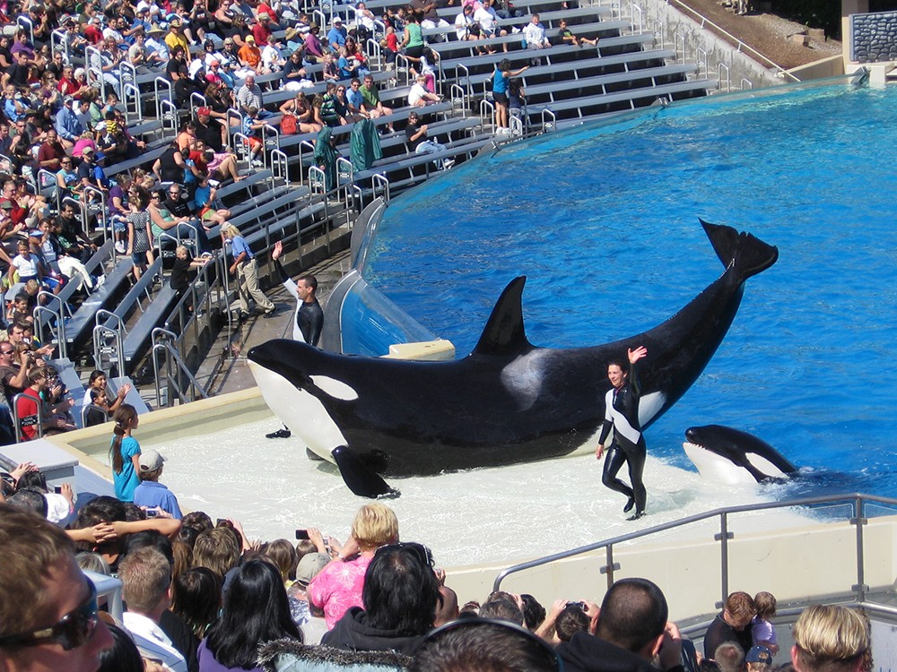
School Events and Field Trips
School Events:
High School Prom
Assemblies
Spirit Weeks
Athletic Events
Talent Shows
Festivals
Grad Night
Graduation Ceremony
Field Trip Opportunities:
Sea World
Whale Watching – Newport Beach
Aquarium of the Pacific –
Long Beach
The Ronald Reagan Library

Slide 21
Counseling Website
www.glc-hs.weebly.com

